Slide 1
ADVOCACY
Women’s Empowerment Principles
WEPs

Slide 2
UN Global Compact

Slide 3
Sustainable Development Goals

Slide 4
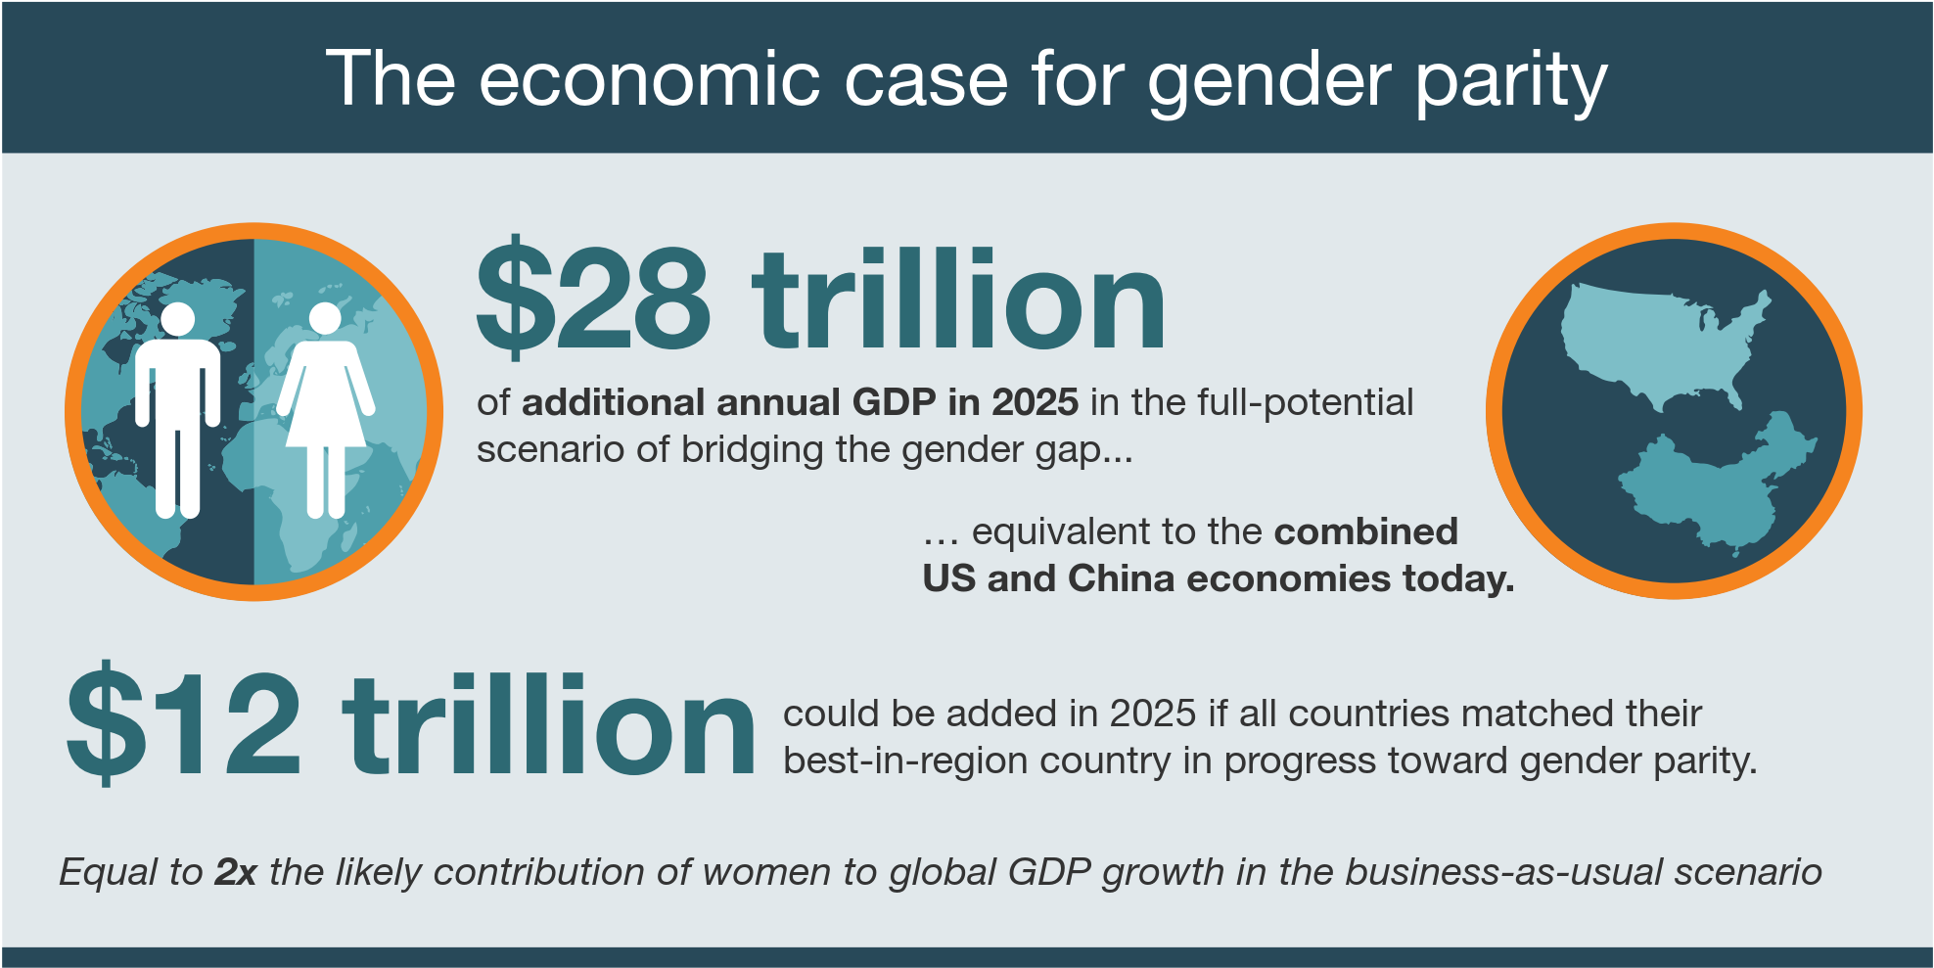
Gender Equality – Why?
VIDEO: http://www.imf.org/b47fc82c-9728-447c-83b0-074060c85b87

Slide 5
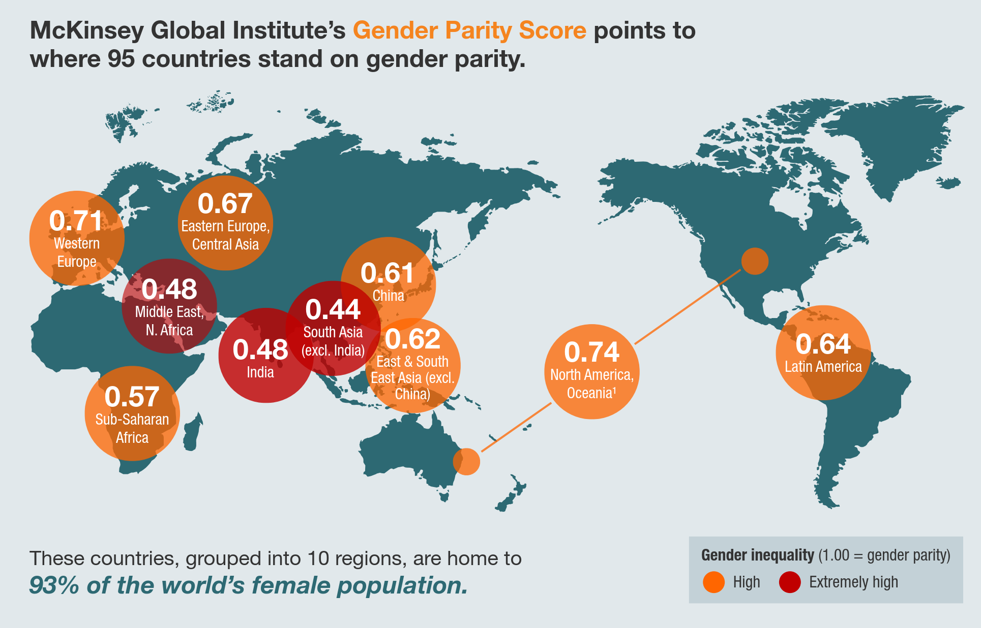
Gender Equality – How far are we today?

Slide 6
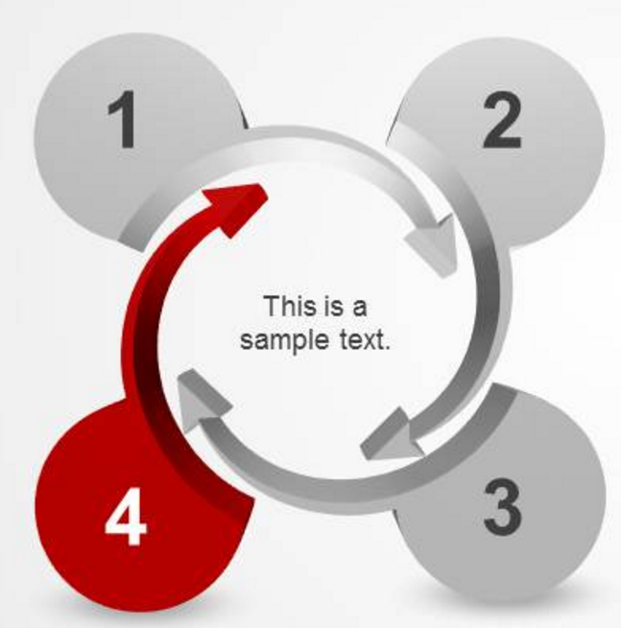
Women’s Empowerment Principles
ASSESS AND DEFINE
COMMIT
WEPs
IMPLEMENT AND MEASURE
COMMUNICATE

Slide 7
WEPs Impact
To date, more than 1450 CEOs representing a range of sectors have signed a CEO Statement of Support for the WEPs.
Notes:
As of June 2017, more than 1450 CEOs representing a range of sectors have signed a CEO Statement of Support for the WEPs.
To see the most recent list of signers please visit the searchable database on the WEPs website under CEO Statement/ Companies

Slide 8
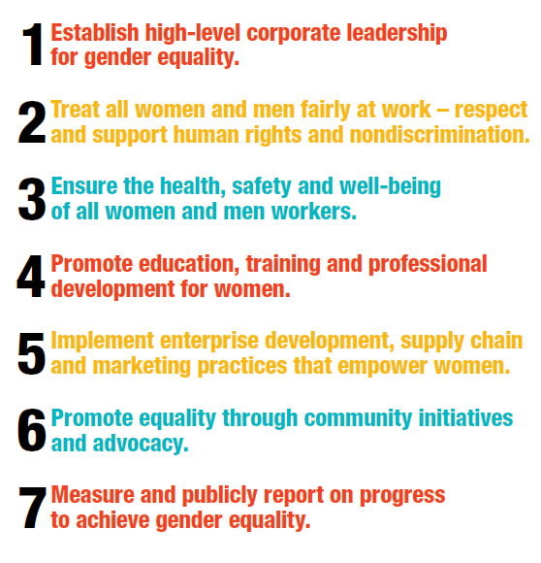
How to Sign
https://www.zonta.org/Global-Impact/Advocacy/Womens-Empowerment-Principles http://www.weprinciples.org/Site/Companies/#search
http://weprinciples.org/Site/HowToSign/

Slide 9
Principle 1
Establish high-level corporate leadership for gender equality
Important to take the time needed
1
2
3
Define strategy for advancing gender equality
Establish a high-level task force to identify priority areas, establish benchmarks and monitor progress
Include company-wide goals for progress toward gender equality in job descriptions and performance reviews
http://weprinciples.org/Site/MakingAndMeasuringProgress/

Slide 10
Principle 2
Treat all women and men fairly at work – respect and support human rights and nondiscrimination
Publicize statements on gender equality in hiring, retention, promotion, salaries and benefits
Recruitment strategies to reach out to more women
Establish & implement a confidential grievance policy & procedure for incidents of discrimination, sexual harassment and gender-based violence
Review & analyse remuneration of all employees by gender, category and job title
Ensure equal opportunities to lead on important assignments and task forces
Survey the views
of women and men towards company policies on equal opportunity, inclusion, non-discrimination and retention

Slide 11
Principle 3
Ensure the health, safety and well-being of all women and men workers
Prominently publicize the company's zero tolerance policy and provide ongoing training.
Undertake a gender-sensitive inventory of health and safety conditions.
Survey employees to elicit the views of women and men on health, safety and security issues.
Tailor company health and safety policies to serve the distinctive concerns and needs of women and men, including pregnant women, people with HIV /AIDs, people with disabilities and other vulnerable groups and provide the resources to implement them.
Notes:
Add nursing mothers

Slide 12
Principle 4
Promote education, training and professional development for women
Train and educate employees, particularly male staff, on the company’s business case for women’s empowerment.
Offer career clinics and mentoring programmes for women’s career development at all stages.
Promote training programmes tailored for women.

Slide 13
Principle 5
Implement enterprise development, supply chain and marketing practices that empower women
Executive level policy statement on the organization’s support for gender equality practices in its supply chain.
Publicize
Identify
‘women’s enterprise champion’ within the organization to target women-owned enterprises and help develop their capacity to become quality suppliers.
Information from current and potential suppliers on their gender and diversity policies and include these in criteria for business selection.
Request

Slide 14
Principle 6
Promote equality through community initiatives and advocacy
Define company community engagement initiatives that empower women and girls.
Encourage company executives to undertake community consultations with local leaders –women and men—to establish strong ties and programmes that benefit all community members.
Craft a community impact analysis that marks the specific impacts on women and girls when establishing or expanding presence in a community.

Slide 15
Principle 7
Measure and publicly report on progress to achieve gender equality
Report annually, by department, on company gender equality plans and policies, using established benchmarks.
Publicize findings on company efforts towards inclusion and advancing women through all appropriate channels and pre-existing reporting obligations.
Include monitoring and evaluation of company gender equality goals into ongoing performance indicators.
http://weprinciples.org/Site/CommunicationOnProgress/#Gender-Specific_Questions

Slide 16
Testimonials
"In 2003, when we joined the UN's Global Compact, we had 4,406 women on our own staff. In December 2009, that figure had risen to 8,296 female employees, growing women's participation in the Company's workforce from 12% to 14%. And the best part of this is that women are present in all business and service areas and in all of the Company's operational units nationwide. With the greater integration of women in the company, we are putting into practice one of the values expressed in Petrobras' Strategic Plan for 2020, which is respect for human and cultural diversity, based on three principles: non-discrimination, equal opportunities, and respect for differences. To achieve these goals, Petrobras is part of the Pro-Gender Equality Action Plan. Coordinated by the Brazilian Government with support from UNIFEM and the ILO, this Plan aims to achieve gender equality in the labor market and to eliminate all forms of discrimination.
"Among the initiatives Petrobras has already implemented under this plan, we can mention the installation of breastfeeding support rooms in Company units and the extension of the maternity leave period to 180 days. Petrobras also participates in the National Pact to Combat Violence against Women, disseminating information on combating domestic and family violence across the country. These are examples of actions that underpin the Company's commitment to the UN Global Compact and to the Women's Empowerment Principles.“
José Sergio Gabrielli, CEO, Petrobras

Slide 17
THINGS TO CONSIDER

Slide 18
Principle 1
Establish high-level corporate leadership for gender equality
Things to consider…
Is the stated commitment to advancing equality and promoting non-discrimination and fairness prominently featured on the company’s website, in company recruiting materials and corporate sustainability reports?
Is there a designated board-level individual who champions the organization’s gender equality policies and plans?
Are there trainings, including for male leaders, on the importance of women’s participation and inclusion?
Does the company’s annual report or sustainability report include leadership statements on reaching gender equality goals?

Slide 19
Principle 2
Treat all women and men fairly at work – respect and support human rights and nondiscrimination
Things to consider…
Is there a gender breakdown of the company’s board of directors and top management?
Does the company track and analyse promotions by gender, employee category and title?
Are fair pay reviews conducted on a regular basis?
Are sufficient numbers of women – 30 percent or greater – being recruited and interviewed?
Do interview panels have sufficient numbers of women participating?
What is the retention rate for female employees by employee category and job title compared to male employees?
Has the company designed flexible work options that incorporate the specific and different needs of women and men?
Are there accessible channels for filing grievances on gender-based discrimination, harassment and violence?
Are there places where nursing mothers can pump or breastfeed separate from bathroom facilities?
Notes:
Are there places where nursing mothers can pump or breastfeed, separate from bathroom facilities?

Slide 20
Principle 3
Ensure the health, safety and well-being of all women and men workers
Things to consider…
Is safety and other equipment the appropriate size for both women and men ?
Are there separate toilets and, if necessary, changing facilities for both women and men?
Are company grounds adequately lit?
Are female health care professionals available in company-provided health services?

Slide 21
Principle 4
Promote education, training and professional development for women
Things to consider…
What is the distribution between women and men of training and professional development opportunities?
How many hours of training do women and men participate in annually, analysed by job category and title?
Are the demands of employees’ family roles considered when scheduling trainings and education programmes?

Slide 22
Principle 5
Implement enterprise development, supply chain and marketing practices that empower women
Things to consider…
Does the company perform analyses of its existing supply chain to establish the baseline number of suppliers that are women-owned enterprises?
How many of the company’s suppliers have gender equality policies and programmes?
What is the ratio of women-owned enterprises compared to other suppliers?
How does the company record complaints regarding its portrayal of women and girls in marketing and other public materials, and how does it act on these concerns?

Slide 23
Principle 6
Promote equality through community initiatives and advocacy
Things to consider…
What initiatives are supported by the company to promote equality in the community and how many women and girls, men and boys do they reach?
Does the company survey participants through focus groups or written comments for feedback?
Does the company review its criteria and policies that determine community engagement activities against results and community feedback?
Are women’s contributions to their communities recognized and publicized?

Slide 24
Principle 7
Measure and publicly report on progress to achieve gender equality
Things to consider…
Does tracking along the benchmarks for advancing women demonstrate that the company is moving positively?
What opportunities exist throughout the company for review, analysis and discussion of performance?

Slide 25
Reporting
The Communication on Progress (COP)
Describes policies and practices related to supporting women’s empowerment and advancing gender equality in the workplace
Describes policies and practices related to supporting women’s empowerment and advancing gender equality in the marketplace
Describes policies and practices related to supporting women’s empowerment and advancing gender equality in the community
Contains or refers to sex-disaggregated data
http://weprinciples.org/Site/CommunicationOnProgress/#Gender-Specific_Questions

Slide 26
WEPs Events

