Slide 1
Zonta International and the Council of Europe
ZI Council of Europe Committee
Biennium 2018-2020
Anita Schnetzer-Spranger, ZI CoE Committee Chair

Slide 2

The Council of Europe (CoE) is Europe’s leading human rights organization
Notes:
The Council of Europe is an intergovernmental organization. It was set up on 5 May 1949, to promote democracy and to protect human rights and the rule of law in Europe.

Slide 3

The Council of Europe (CoE) is NOT an institution from the European Union! (EU)
Separate organizations
Notes:
Do not mix up the Council of Europe with the European Council – which is the decision making body of the EU –
CoE and EU are separate institutions, have different roles but share the same values and symbols such as the European flag.
No country has ever joined the EU without first belonging to the Council of Europe.

Slide 4

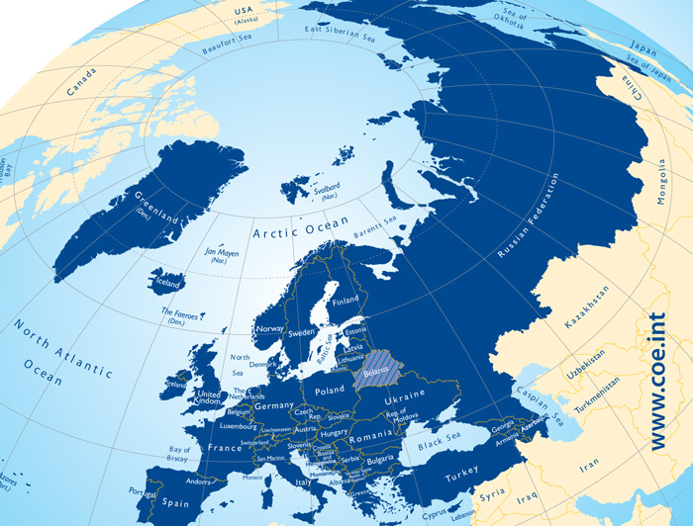
The CoE has 47 member states
and 6 observer states, such as Canada, Holy See, Israel, Japan, Mexico and United States of America
28 member states are also members of the EU
It represents more than 820 million citizens
Hereunder more than 400 million women and girls

Slide 5
European Convention on Human Rights
A treaty designed to protect human rights, democracy, and the rule of law
A precondition for the membership in the Council of Europe is the signing of the Convention by the acceding states.
The member state becomes, thus, also a party of the European Court of Human Rights, which oversees the implementation of the Convention.
Notes:
All CoE member states have ratified the ECHR and are, therefore, legally bound by this treaty. The ECHR was signed in Rome 1950, went into force 1953.
The crucial point of the European Court of Human Rights is, that every individual can file a complaint against a member state if the state has infringed his/her human rights, covered by the Convention. This is unique in the world and sets the European Court of Human Rights apart from other Human Rights Institutions.

Slide 6
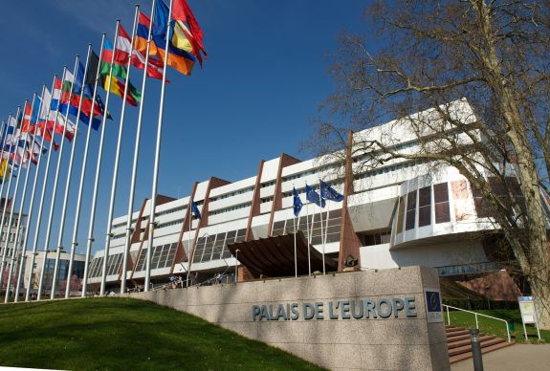
Where does the CoE hold its meetings?
Strasbourg, France
Notes:
Both, the Council of Europe and the European Court of Human Rights have their permanent seats in Strasbourg, France.

Slide 7
Global Cooperation
  The Council of Europe works with the European Union (EU)
  The Council of Europe cooperates with:
  the United Nations (UN)
  the Organization for Security and
Co-operation in Europe (OSCE)
The Council of Europe cooperates
with countries and organizations worldwide
Notes:
Organizations like OECD, UNICEF, UNESCO, IMF to name only a few.

Slide 8
Council of Europe structure
Within the structures of the Council of Europe there are several bodies.
• The Committee of Ministers (decision-making body) • The Parliamentary Assembly (deliberative body) • The Congress of Local and Regional Authorities (consultative body) • The Conference of INGOs (ZONTA, consultative body, participatory status)
• The European Court of Human Rights
• The Commissioner for Human Rights
Notes:
The structure of the CoE is based on four pillars: the Committee of Ministers (Foreign Ministers), as the decision making body, the Parliamentary Assembly as the deliberative body, the Congress of Local and Regional Authorities and the Conference of the INGOs as the consultative bodies. Zonta is one of 320 INGOs enjoying participatory status.

Slide 9
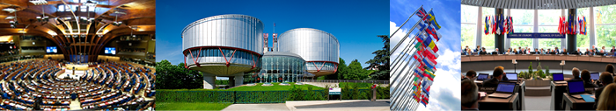
The Conference of INGOs
The Conference of International Non-governmental Organizations (INGOs) is recognized as an institution of the CoE
The Conference is one of the four institutional pillars of the Council of Europe “quadrilogue” and is composed of about 320 INGOs
The Conference is the chief body representing INGOs with participatory status, the official voice of Europe’s civil society
Notes:
Independent non-governmental organizations are a vital component of European society, guaranteeing freedom of expression and association both of which are fundamental to democracy.
Recognizing their influence, the Council of Europe provides international NGOs (INGOs) with the opportunity to acquire participatory status. Zonta has been represented in the CoE since 1983, with participatory status since 2003.

Slide 10
The work of the
Conference of INGOs
Identifies the general action needed to organize its participation
Decides on policy lines and defines and adopts action programs
Helps to affirm the political role of civil society at the CoE
The Conference of INGOs
Notes:
The Conference of INGOs takes a vital part in the CoE and asserts the political role of civil society. It enables INGOs to increase active participation in the policies and work program of the CoE. The Conference contributes directly to debates, resolutions or recommendations.

Slide 11
The work of the
Conference of INGOs
Education and Culture
Thematic Committees
Democracy, Social Cohesion and Global Challenges
Human Rights
Notes:
The committees are responsible for the Conference‘s work in the priority fields human rights, democracy and education. Actions are described in their two years roadmaps. Each committee sets up a strategy with relevant topics, dealt with in special working groups. The topics are aligned with the issues set up by the Committee of Ministers, but can also pick up burning issues of society.

Slide 12
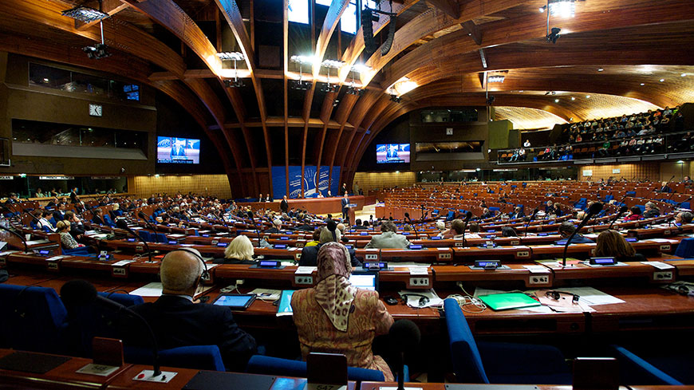
Zonta’s participatory status at CoE
Zonta
has the right to approach and work with all bodies of the CoE
Zonta
can approach directly Parliamentarians and make our issues known to them
Zonta
participates in meetings of the Parliamentary Assembly Committee (PACE)

Slide 13
Added value to ZI through its participatory status
Visibility and trust
Contributes directly to debates, resolutions or recommendations
Part of the consultation processes
Participates in international conferences, seminars and projects
Participates in the World Forum of Democracy
Introduces specific themes to be raised/discussed at INGO Conference
Votes and influences decisions
Actively supports gender equality issues amongst the most important representatives of Europe’s civil society
Notes:
As part of the Conference of INGOs ZI is allowed to participate in the vital dialogue to fight for women‘s rights and gender equality

Slide 14
What can Zontians do?
Examples: Concrete advocacy tools for advocacy action with an impact
„Istanbul Convention“
Council of Europe Convention on Preventing and Combating Violence against Women and
Domestic Violence (set up 2010)
Monitoring body: GREVIO
1st
http://www.coe.int/en/web/istanbulconvention/home
Council of Europe Convention on Action against Trafficking in Human Beings (set up 2005)
Monitoring body: GRETA
2nd
http://www.coe.int/en/web/anti-human-trafficking/home
Notes:
The CoE has produced over 200 treaties to promote human rights, democracy and the rule of law. Most important for us and our advocacy work are the far reaching and legally binding conventions, the Istanbul Convention and the Anti-Trafficking Convention. Legally binding means, once the member state has signed and ratified the convention/treaty, he is obliged to implement the requirements of the convention by adapting the national law and by setting up the provisions.
A crucial part of the conventions are the Monitoring Mechanisms. They assess how well its requirements and provisions are put into practice. Their findings and recommendations will help to ensure states’ compliance with the convention and guarantee its long-term effectiveness.
The Council of Europe Convention on Preventing and Combating Violence against Women and Domestic Violence was signed on 11 May 2011 in Turkey- therefore named ”Istanbul Convention.” It entered into force in August 2014. As of July 2018, 16 member states have signed the convention but not yet ratified. 30 member states have ratified the convention.
The Council of Europe Convention on Action against Trafficking in Human Beings , “the Anti-Trafficking Convention”, was opened for signature on 16 May 2005 and entered into force in 2008. As of July 2018, 47 CoE member states have ratified the convention.
The third ground-breaking, unique and comprehensive convention in the area of gender equality and human dignity is the Convention on the Protection of Children against Sexual Exploitation and Sexual Abuse (“Lanzarote Convention”).

Slide 15
What can Zontians do?
Act as “watch dog”.
Educate yourself with the conventions on women’s rights, urge your government to ratify, follow the implementations of the conventions.
Follow legislation and decision-making in your country.
Be active in contacting Parliamentarians and regional/local reps.
Work in cooperation with like-minded NGOs.
Demand information , dialogue, public hearings concerning government reports to international bodies on women’s rights conventions.
Raise awareness and influence public opinion by organizing lectures, seminars on women’s rights.
Educate Zonta members, find facts for effective advocacy action.
Notes:
HeForShe, #MeToo, and other topical issues provide ground for arranging events, for civil participation and influence on decision-making. Be timely in expressing well-prepared opinions.

Slide 16
Why is the Istanbul Convention important to Zonta?
The Convention is open to accession by any country in the world!
Zonta International strives to promote and protect the human rights of all women/girls and to reduce violence against women.
Whether in Europe or anywhere else in the world, Zontians can use the Istanbul Convention as a tool for advocacy!
The Istanbul Convention will give more strength to the ‘Zonta says NO!’ campaign!
Notes:
For Zonta, the Istanbul Convention is a practical tool to advocate for gender equality and women‘s rights and to take advocacy into action, also as heart of the Zonta Says NO-Campaign.
Zonta can contribute with its power, knowledge and persuasion by raising awareness in all 62 Zonta countries around the world to this first legally binding instrument/treaty to fight VAW and domestic violence. Zontians can follow the monitoring reports of their government and of the Grevio Group in their countries to see if their government meets the requirements of the Istanbul Convention.
Can non-European countries join? The Convention is open for accession by any country in the world – provided that the country has been formally invited to accede by the Committee of Ministers of the CoE.

Slide 17
What does the Convention criminalize?
Domestic violence
Stalking
Sexual violence, including rape
Sexual harassment
Forced marriage
Female genital mutilation
Forced abortion or forced sterilization
Psychological harm
Notes:
The Convention criminalizes all forms of violence, all of which Zonta International is fighting through its ZSN-Campaign and most of which ZI is fighting through the international service projects. The Convention requires states and parties to criminalise or otherwise sanction the following behaviours:
Domestic violence (physical, sexual, psychological or economic violence)
Stalking
Sexual violence including rape
Sexual harassment
Forced marriage
Female genital mutilation
Forced abortion or forced sterilisation
Psychological harm
This biennium Zonta is continuing to fight Early and Forced Marriage. A severe violation of human rights and the dignity of women and girls. Over 650 million women alive today were married before their 18th birthday. The Istanbul Convention is fighting Forced and Early Marriage and will therefore be a meaningful tool for clubs to advocate for the right of women and girls.

Slide 18
The CoE is fighting for……
Women‘s rights
Says NO to Violence against Women and Girls
Istanbul Convention
Anti-Trafficking Convention
Lanzarote Convention
Gender Equality
Says YES to Gender Equality
Gender Equality Strategy 2014-2017
2018-2023
Notes:
Achieving gender equality is central to the fulfilment of the CoE‘s mission: Safeguarding human rights, upholding democracy and preserving the rule of law.
1. Combating Gender Stereotypes and Sexism
2. Preventing and Combating Violence against Women
3. Guaranteeing Equal Access of Women in Justice
4. Achieving Balanced Participation of Women and Men in Political and Public Decision-Making
5. Achieving Gender Mainstreaming in all Policies and Measures
6. Protecting the rights of migrant, refugee and asylum-seeking women and girls

Slide 19
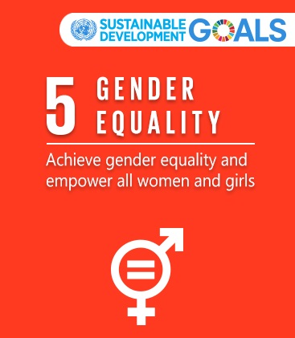
The CoE and the UN 2030 Agenda
Ground-breaking, unique, comprehensive conventions: Istanbul Convention, Anti- Trafficking Convention.
The CoE Gender Equality Strategy 2014-2017 and 2018-2023.
Notes:
For the CoE achieving gender equality is central to its core values. The CoE‘s comprehensive and extended body of standards and work related to gender equality, as well as regular monitoring of the implementation of these standards by the CoE Gender Equality Commission and the Committee of Ministers, provide important input towards the efforts of the member states to achieve the UN SDGs.

Slide 20
2018-2020 Goal NO 1: Maximize our impact through advocacy initiatives
The ZI CoE Committee‘s goal:
Represent Zonta in relevant discussions and decisions at the CoE.
Train and educate members on issues pertaining to women‘s rights and gender equality by the CoE.
Notes:
The ZI CoE Committee‘s main goal is to inform and educate members around the world on relevant conventions/treaties and mechanisms of the CoE to help advcocate effectively for women‘s rights and gender equality. In cooperation with the ZI UN -and Advcoacy Committees we will support clubs and districts to raise civil society‘s voice and to fight the serious human rights violations wich are done to women and girls solely because they are born female.

Slide 21
Further information or questions
Anita Schnetzer-Spranger, Chairman, D 28
Zonta Club of Mainz, Germany
schnetzer-spranger@gmx.de
Irma Ertman, Vice-Chairman, D 20
Zonta Club of Helsinki II, Finland
ertman.irma@gmail.com
Tuija Heikkilä, Member, D 20
Zonta Club of Tampere, Finland
tuija.heikkila@kolumbus.fi
Karin Nordmeyer, Legal Advisor, D 30
Zonta Club of Freiburg-Schauinsland, Germany
knordmeyer@gmx.de

