Slide 1
Final Reflections

Slide 2
Centennial Anniversary Endowment Campaign
Beginnings
Achievements
Impact
Future
Notes:
As the Centennial Anniversary Endowment Campaign comes to a close, it is timely to reflect on how and why the Campaign was developed, its achievements, the impact it has had, and its future.

Slide 3
1988 Zonta International Endowment Fund established
Beginnings
Notes:
First, the starting point for the Campaign was the decision made by Zonta International in 1988 to establish an Endowment Fund as an unrestricted fund within the Zonta International Foundation, investing US$97,123 from unallocated service funds.
The rationale was that such a fund was necessary to ensure a long-term source of income for the Foundation and enable Zonta’s programs and projects to continue in perpetuity.
The key concept underpinning this approach was that only the interest and dividends from investments would ever be spent; the principal would remain intact.
At the same time, its status as an unrestricted fund ensured that funds could be accessed if needed to support Zonta’s projects and programs.

Slide 4
1988 to 2014 Fund reaches USD$1.1 million
Notes:
Through contributions over the next 27 years, the Fund’s principal grew to US$1.1 million by 2014

Slide 5
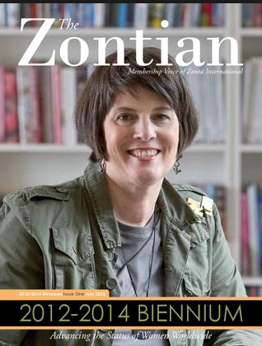
2014 CAEC launched
Notes:
At this point, the international board, led by International President Lynn McKenzie, launched a bold and ambitious campaign to grow that US$1 million to US$10 million by Zonta’s 100th anniversary in 2019.
The result was the Centennial Anniversary Endowment Campaign.

Slide 6
Pathway to Success
Financial Goal
US$10 million
Member Education
Global Leadership
Promotional Materials
Policies, Procedures
and
Recognition
Network Structure
Notes:
It was recognized at the outset that there were several critical steps on the pathway to success.
The first step was to establish a financial goal.
Taking a conservative estimated rate of return of 5.4 per cent, a figure of US$10 million was determined as the critical amount needed to generate sufficient income through interest and investment dividends to ensure the future of Zonta’s international programs and projects.
The second critical decision was how the campaign would be led.
A committee of five respected, high-profile Zonta leaders was established within the Foundation to provide overall campaign direction.
It was clear from research of other endowment funds that the committee needed to have global reach and that its members should be donors whose personal experience would enable them to provide leadership and act as passionate advocates for the Fund.
The members appointed were: PIP Olivia Ferry (Philippines), Sharron Miles (USA), PIP Val Sarah (Australia), and Anita Schnetzer-Spranger (Germany) with Jackie Beaudry as Chairman and the current Zonta International President and President-Elect as ex officio members, and Amy Lai (Taiwan) as an honorary member.
The third key element was structure.
A staff member at headquarters was designated as liaison for the Committee, and to achieve global reach, a network of Regional Representatives was implemented in 2016 – Australia and New Zealand, chaired by PIP Val Sarah; Europe, chaired by Anita Schnetzer-Spranger, North America, chaired by Sharron Miles; and Asia, chaired by PIP Olivia Ferry.
The chairmen of each geographical group approached key Zontians in their designated districts, inviting them to become Regional Representatives.
These members then received training to enable them to approach potential donors and to make presentations in various Zonta settings.
By the end of the campaign, the initial group of 40 Regional Representatives in 2016 had grown to 54 – an increase of 35 percent, with the majority committed to continuing in the role into the future.
Flowing from the structure, a suite of policies and procedures was developed, including a program of donor recognition.
Promotional materials including information folders for prospective donors, brochures, PowerPoint presentations, training materials and videos were designed and distributed by headquarters staff with the input and support of committee members and Regional Representatives. The materials for the Mary E. Jenkins 1919 Society (Zonta’s Planned Giving Program) were updated.
Once these four elements were in place, the final and essential element was member education, with the committee members and Regional Representatives providing information, responding to questions, making presentations, providing leadership, and developing member understanding of the nature of endowment funds.

Slide 7
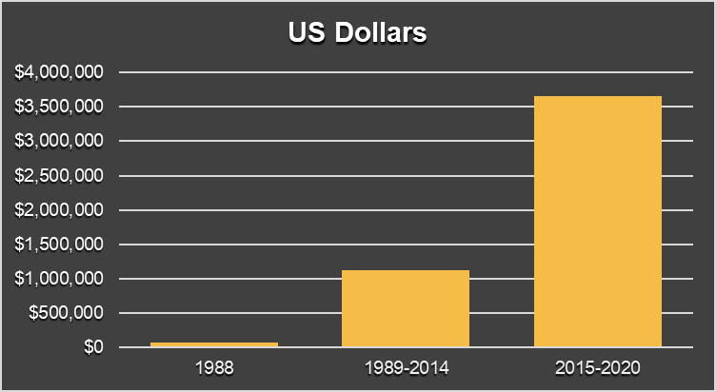
Endowment Contributions
Achievements
Average $731,150
per year
(5 years)
Average
$41,514
per year
(27 years)
Initial contribution of US$97,123
Notes:
Against that background to the Campaign, we now turn to considering its achievements.
The most telling demonstration of the success of the Campaign and those who led it, is to consider the average annual contributions made to the Fund since 1988.
Over the 27 years from 1988 to 2014, the average annual contribution was approximately US$41.5 thousand.
Over the five years from 2015 to the end of the Campaign, the average annual contribution has grown to over US$731 thousand.
This is a remarkable achievement of which every Zontian can be proud.

Slide 8
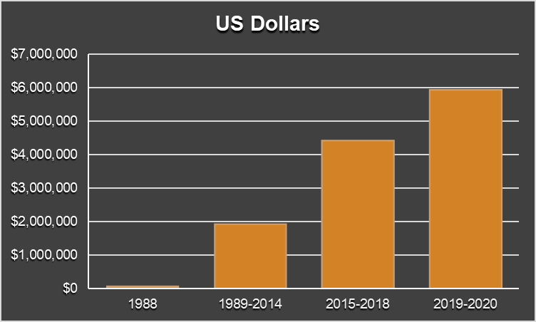
Endowment Growth
$5.9 Million
$4.4 Million
$1.9 Million
$97 Thousand
Centennial Anniversary Endowment Campaign
Notes:
This graph shows how significant the Campaign has been in growing the Fund.
Compared with the initial period from 1988 when the Fund was established, the last six years have seen significant growth in principal and earned income.

Slide 9
Contributions
Individual Members
7%
Clubs
28%
Districts
56%
Notes:
Thanks to the greatly increased awareness among members, contributions from individuals, clubs and districts have shown impressive growth:
7 percent of individual Zontians around the world have contributed to the Fund,
28 percent of Zonta clubs world-wide have made contributions, and
56 percent of Zonta’s 32 Districts have allocated funds to the Fund, with 18 of Zonta’s total of 32 districts making contributions in their own right, over and above the donations given by clubs.
This is an outstanding achievement and we thank every one of these many individuals, clubs and districts for their generosity.

Slide 10
Individual Donors
US$100,000 or more
The
Kaleta A. Doolin Foundation
Judith F. Kautz
Vivien W. Yen
Notes:
While every contribution has made a difference, there are some individual donors who have made a truly exceptional contribution:
The Kaleta A. Doolin Foundation
Judith F. Kautz
Vivian W. Yen

Slide 11
Individual Donors
US$50,000 - US$99,999
Jacqueline M. Beaudry
Shu Lan H. Chiu
Glenne Harding
Sally S. Bean
Eleanor Jammal
Toshie Yamazaki
Elizabeth Whitham
Amy Lai
Notes:
A further eight individuals have also enabled the Fund to grow to an unprecedented level in recent years through their generous gifts and bequests:
Sally S. Bean
Jacqueline M. Beaudry
Shu Lan H. Chiu
Glenne Harding
Eleanor Jammal
Amy Lai
Toshie Yamazaki
Elizabeth Whitham

Slide 12
Clubs and Districts
Top Donors
Clubs | US$
New Territories | 100,712
Taipei I | 37,000
Hong Kong | 30,000
Victoria, Hong Kong | 30,000
Kaohsiung Yuhsiuan | 19,110
Districts | US$
District 31 | 711,673
District 17 | 551,795
District 26 | 465,797
District 10 | 330,624
District 6 | 276,219
Notes:
We also acknowledge the five individual clubs who have made the highest contributions:
Zonta Club of New Territories
Zonta Club of Taipei I
Zonta Club of Hong Kong
Zonta Club of Victoria, Hong Kong
Zonta Club of Kaohsiung Yuhsiuan
And the top districts with highest total giving comprised of donations from their active members, clubs, areas, and district board contributions:
Districts 31, 17, 26, 10 and 6

Slide 13
Impact
Zonta’s
future
ensured
Zonta’s
status
maintained
Zonta’s
programs and projects
assured
Notes:
It is important to consider the impact of that result.
First, it will ensure that Zonta maintains its status and reputation as a leading global organization of professionals, committed to empowering women worldwide through service and advocacy
Second, it will assure the future of Zonta’s service projects and education scholarships in business, technology, public affairs and aerospace-related science and engineering, which help to create a stronger, more equal future for women and girls
Finally, it will ensure that Zonta can continue to advocate for a world in which women’s rights are recognized as human rights, in which every woman is able to achieve her full potential, and in which no woman lives in fear of violence

Slide 14
Future
US$10 million
by 2028
International
committee
continues
Regional Representatives
continue
Notes:
While the Centennial Anniversary Endowment Campaign ends with the start of the new biennium in July 2020, the goal of raising US$10 million will continue, building on the momentum created over the past six years and the greater understanding among Zontians of the role and importance of the Endowment Fund.
With an estimated annual return of 5.4 per cent and the continued support of Zontians around the world, the committee believes that the goal of US$10 million can be reached by the 2026-2028 biennium.

Slide 15
Thank you!
Notes:
As our 100th anniversary celebrations come to an end, it is fitting to reflect on the foresight of our founders.
Those brave and dedicated women shared the wonderful gift of Zonta with us, and their commitment, coupled with ours, has ensured a stable organization which will serve women and girls well into the future.
We congratulate and thank the many members, clubs and districts who have contributed to the Fund or have made pledges or bequests.
We also thank those who have given their time, energy and expertise as members of the Endowment Committee or as Regional Representatives.
The Centennial Anniversary Endowment Campaign has produced a legacy of which every Zontian can be proud.

