Slide 1
Area Director Preparation

Slide 2
Developed by the Zonta International Leadership Committee to empower you to empower your clubs to be the best they can be!

Slide 3
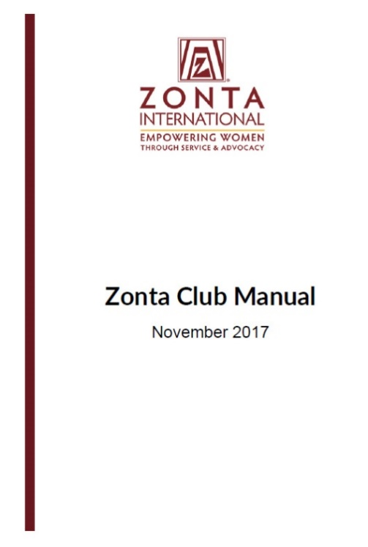
Expected Outcomes
Recognize duties of area director
Identify resources for support
Establish method of officer training
Fulfill form-signing requirements
Determine priority clubs for your area
Prepare for club visits

Slide 4
Area Directors Role
Voting member of district board
Helper
Liaison
Mentor
Problem solver
Trainer

Slide 5
Vice Area Director
Bylaws—Article XIII Districts, Section 8 Vice Area Directors

Slide 6
Area Director’s Tools
District Manual
Club Manual
Zonta e-learning Sessions—especially Governance and Goal-Inspired Leadership
Empower yourself by reviewing these at beginning and midway point so you can use as a reference

Slide 7
AD Responsibilities (1)
Serve as member of the District Board and support Governor’s goals for district.
Report to the governor.
Share district, area, and international information.
Arrange for officer training.
Ensure club leaders have signed the required forms.

Slide 8
Sharing Information
Essential part of Area Director’s role
Critical link between clubs, district and international
Necessary to accomplish biennial goals
Key to helping clubs realize they are part of a bigger picture
Important for club and district success

Slide 9
Required Forms
“Conflict of Interest Declaration Form(s)” for
ZI and ZIF
“Use of Member Information by Zonta Leaders Declaration Form”
(See Conflict of Interest and Use of Member Information under FORMS on membership. zonta.org.)

Slide 10
Area Director Responsibilities (2)
Conduct Area Meetings or Workshops at least yearly.
Communicate with clubs regularly.
Look for future leaders and inform district nominating committee.
Visit each club in person, if possible.
Help struggling clubs.
Have Fun!

Slide 11
Chain of Communication
Member
Club President
Area Director
Governor
International Board Liaison
International Board

Slide 12
Celebrate the Benefits
Working closely with fellow board members
Getting to know other Zontians and club cultures
Growing in personal leadership skills
Broadening your Zonta experience
Empowering other members to grow
Making a difference

Slide 13
Key to Success
All about relationships
Get to know your club presidents

Slide 14
Getting to Know Clubs
Establish how and when you will communicate
Let presidents know you want to attend a business meeting—in person or electronically
Give options when available
Offer to provide a program of interest
Research the club—read newsletters, Facebook pages, websites

Slide 15
Indicators of Struggling Clubs
Membership under 15
Lack of attendance at area and district events
Poor attendance at club meetings
Little or no communication with president

Slide 16
Struggling Clubs
Recognize that clubs seldom ask for help until it is too late
Ask clubs about their challenges and concerns
Track membership carefully
Check personally with your clubs ahead of time to ensure they are participating in area and district events

Slide 17
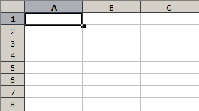
Sample Area Director Form
Club, President contact info
Meetings times and place
Biggest Challenge
Number of members
Recruitment
Fundraising
Service/advocacy

Slide 18
Club Visits
Know officers by name
Acknowledge their recent service or advocacy
Refer to their Zonta International Foundation support
Update latest International, District and Area news
Ask for their input on district issues
Share the program you have prepared

Slide 19
Tips for Success
Let clubs know you are NOT the “Zonta Police”
Closely monitor club membership information in order to offer help
Review recent club history of participation in area, district and international meetings
Know their service and advocacy projects and fundraisers

Slide 20
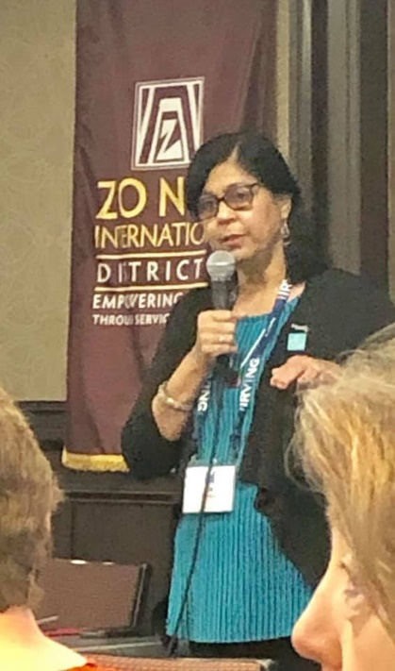
Officer Training
Offer annually on area-wide or region-wide basis
Include info for all club board members
Make it interactive
Use tools available to you
Demonstrate online resources
Use different district experts
Provide handouts

Slide 21
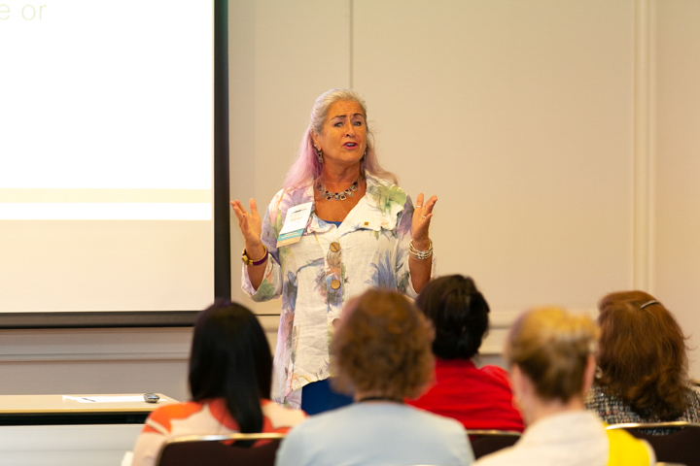
Officer Training (2)
You don’t’ have to be the trainer
You are the organizer
Establish times
Choose format
Arrange for trainers
Invite club officers
Keep track of attendees
Follow up on non-attendees

Slide 22
Officer Training (3)
Survey newly elected officers in as early as possible
Ask 5-10 key questions to identify needs
Design around their needs and office responsibilities
Share PowerPoints and handouts with those who couldn’t make it

Slide 23
Supporting Clubs and District
Recognize that you are often the Ambassador of Zonta International to Zontians in your area
Keep informed by regular visits to zonta.org
Check-in with clubs before area or district events
Monitor the need for proxies at Conference and Convention
Encourage all clubs to participate

Slide 24
Jacquie Gudmundsen, Zonta Club of Pontiac-N. Oakland
Denise Keipert, Zonta Club of Fenton
Annette Binder, Zonta Club Hamburg-Elbufer
Area Directors from Districts 4 and 15

