Slide 1
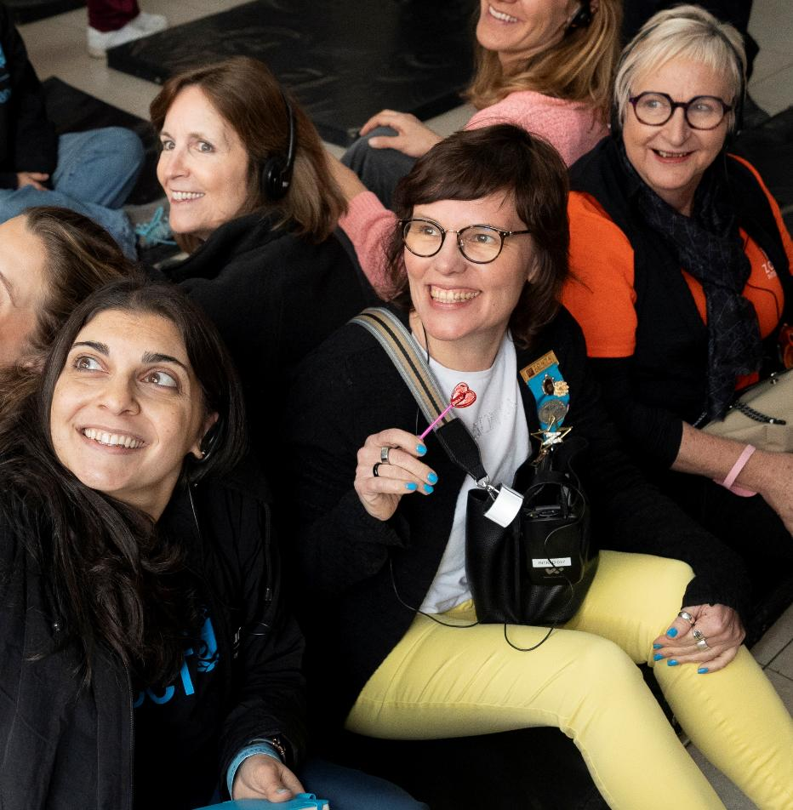
Laaha: A Digital Safe Space
Site visit
ECUADOR, FEBRUARY 2026

Slide 2
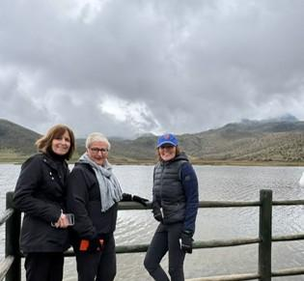
Ecuador: a land of contrasts: shaped by nature, people and inequality
Environment
  From the mountain range (Andes) running through the country, volcanoes, and rugged terrain to the long coastline of the Pacific Ocean with its warmer climate, fishing and UNESCO heritage Galapagos Islands.
  The UNESCO Heritage City of Quito with its historical buildings which contrast with the new city high rise buildings and modern infrastructure.

Slide 3
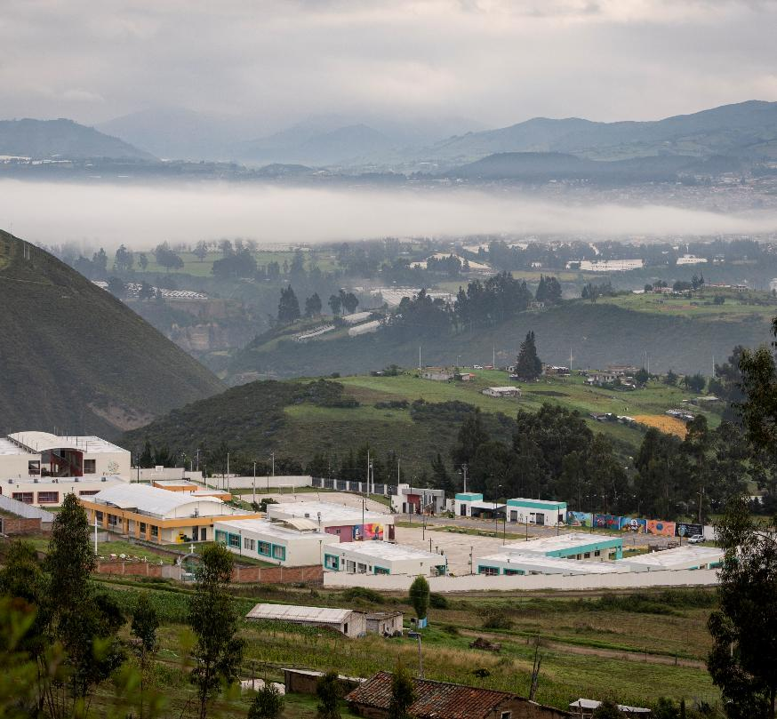
Ecuador: a land of contrasts: shaped by nature, people and inequality
Economy
  Ecuador is considered a middle-income country, but wealth is unevenly distributed.
  The cities (including Quito) are characterized by more jobs and services, better infrastructure and higher average incomes while rural areas have higher levels of poverty; fewer job opportunities and limited access to services.

Slide 4
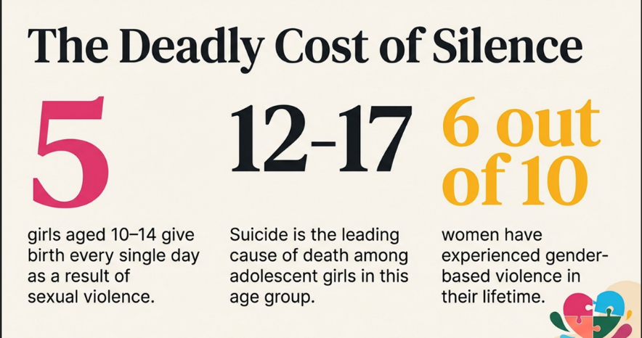
Ecuador: a land of contrasts: shaped by nature, people and inequality
Social conditions
  Social conditions vary widely across the country with indigenous and rural communities facing disadvantages in housing and employment, and access to public services including education and health care.
  Access to education is unequal with fewer schools in rural areas, longer distances for students to travel; higher dropout rates and poorer quality resources.
  Health services (hospitals/specialist care is widely available in the cities but there are limited clinics and fewer medical professionals on rural areas.
Organized crime
  Violence in Ecuador is driven by drug trafficking and gang conflicts. It is a major cocaine transport hub. Over 80k people were internally displaced by violence – forced to leave their homes due to gang threats.
  Quito (capital of Ecuador) one of the six most dangerous cities in the world.

Slide 5
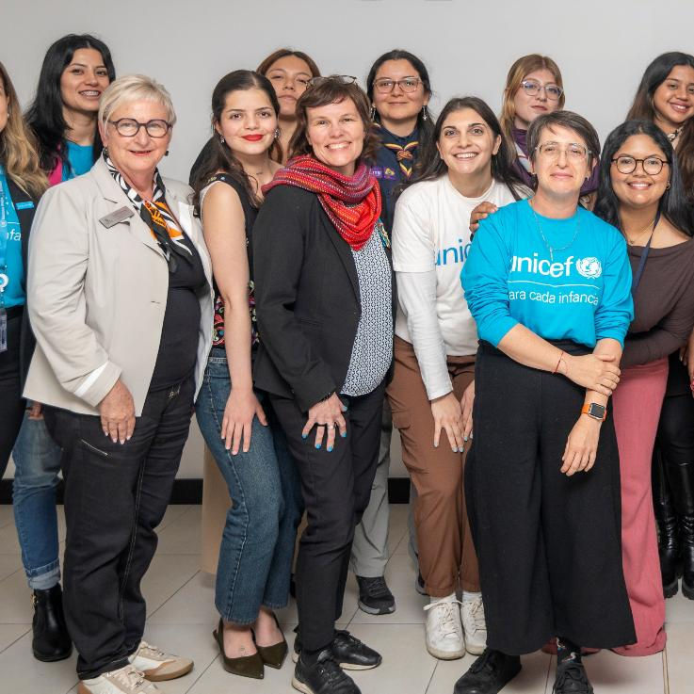
DAY 1
Young women from Generation Plus and
U-Report shared powerful testimonies.

Slide 6
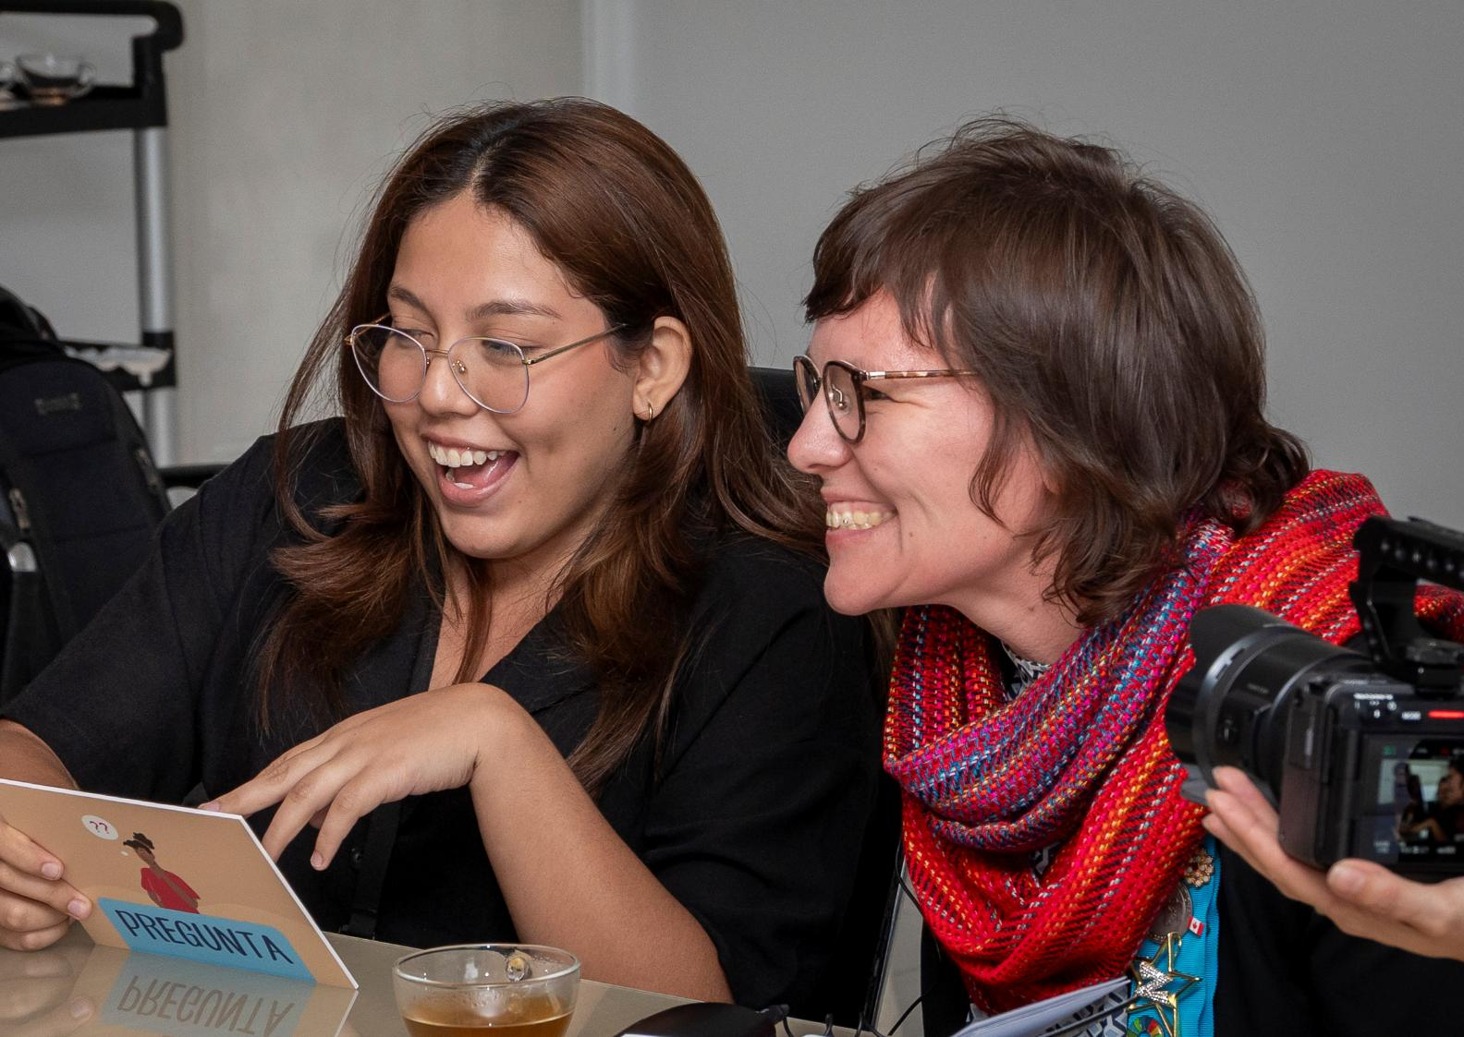
Laaha in Ecuador: shaped by the collective voices of young women and girls
Young women from Generation Plus and U-Report shared their stories.
These young women had worked with UNICEF Ecuador to shape the Laaha resources and tools and enable a better connection with girls/adolescents in Ecuador through:
  Language
  Culture
  Services available to support girls

Slide 7
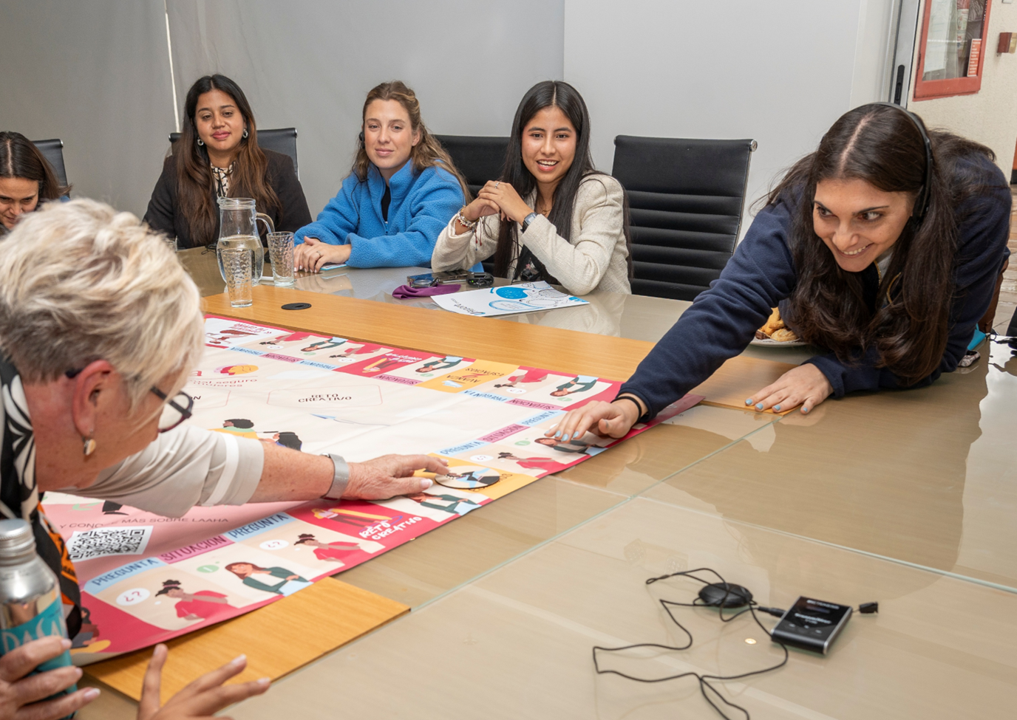
Laaha in Ecuador: shaped by the collective voices of young women and girls
The young women came from all over Ecuador from a range of backgrounds, cultures and experiences.
They openly shared their stories as feminists and activists working with girls and young adolescents.
The passion, drive and commitment of the young women was clear when they spoke.

Slide 8
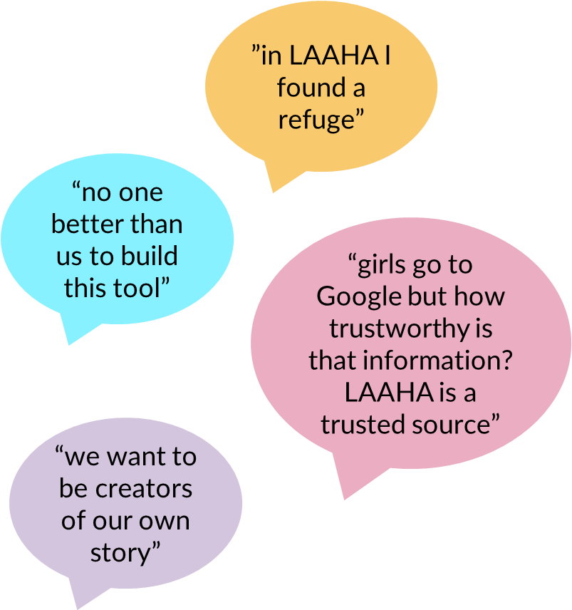
Laaha in Ecuador: shaped by the collective voices of young women and girls
The young women came from a variety of backgrounds, and some had firsthand experience of gender-based violence.
They spoke about their personal experiences of:
  Violence (physical, emotional, online, etc.)
  Low self esteem
  Toxic relationships
  Physical barriers about access to information and services for indigenous people and girls in rural communities.
Many had used the Laaha platform directly or in the services that they provided.
All had positive experiences of Laaha and/or involvement in the program:
  Increase in self-esteem
  Personal growth
  Able to access information on sensitive topics
  Teamwork and sense of community with other women in the group

Slide 9
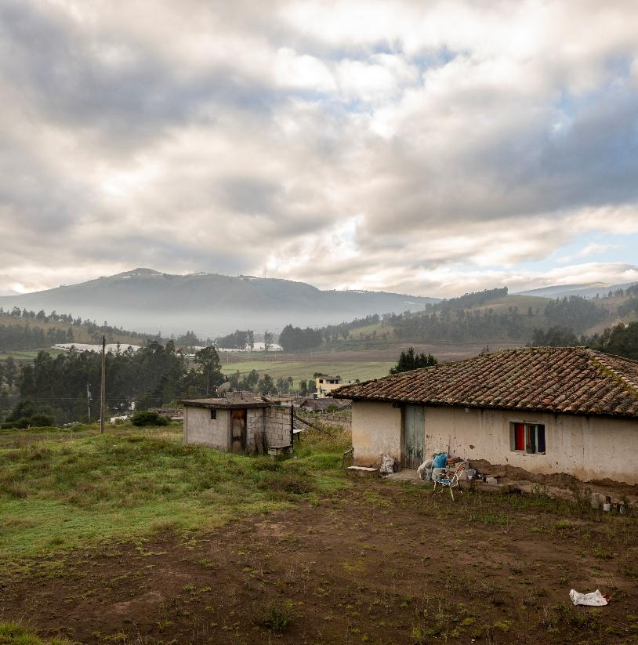
DAY 2
The Zonta and UNICEF team traveled from Quito to Cayambe.

Slide 10
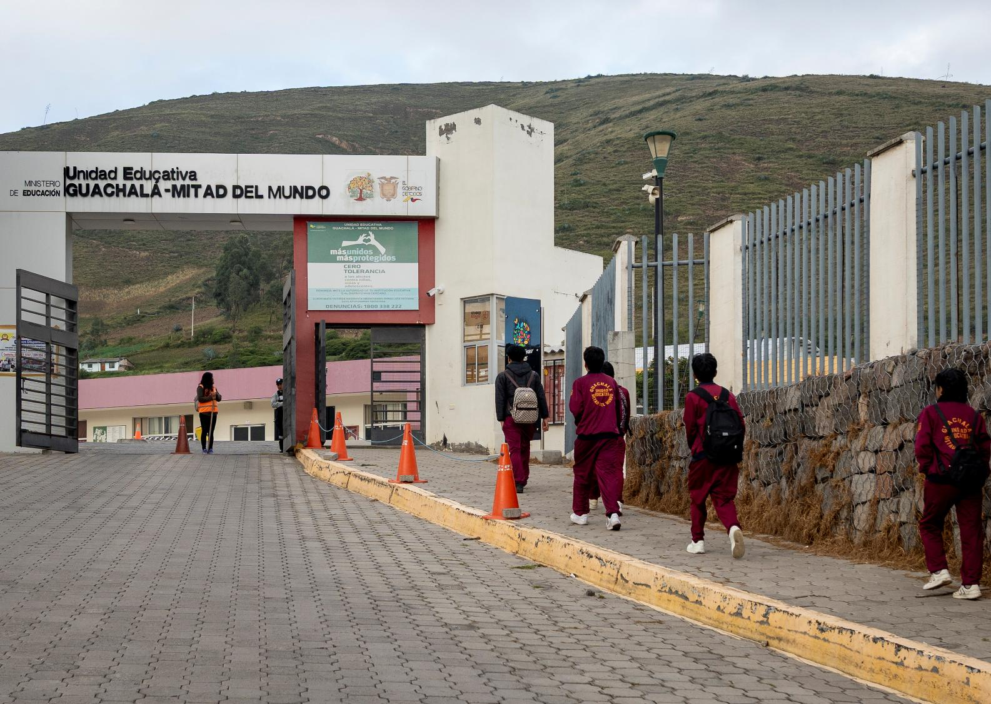
The team visited the Unidad Educativa Guachalá Mitad del Mundo in Cayambe, where Laaha was being integrated into the curriculum.

Slide 11
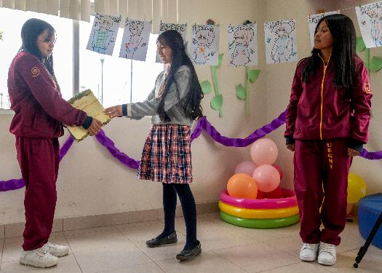
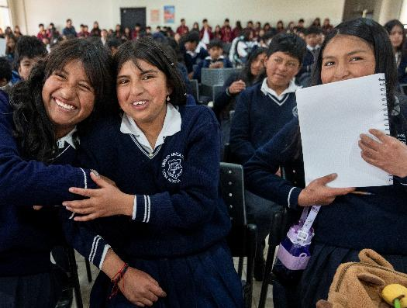
Unidad Educativa Guachalá Mitad del Mundo
Students, teachers and leaders from the surrounding areas visited the school to learn more about Laaha and how the school integrated the Laaha content.

Slide 12
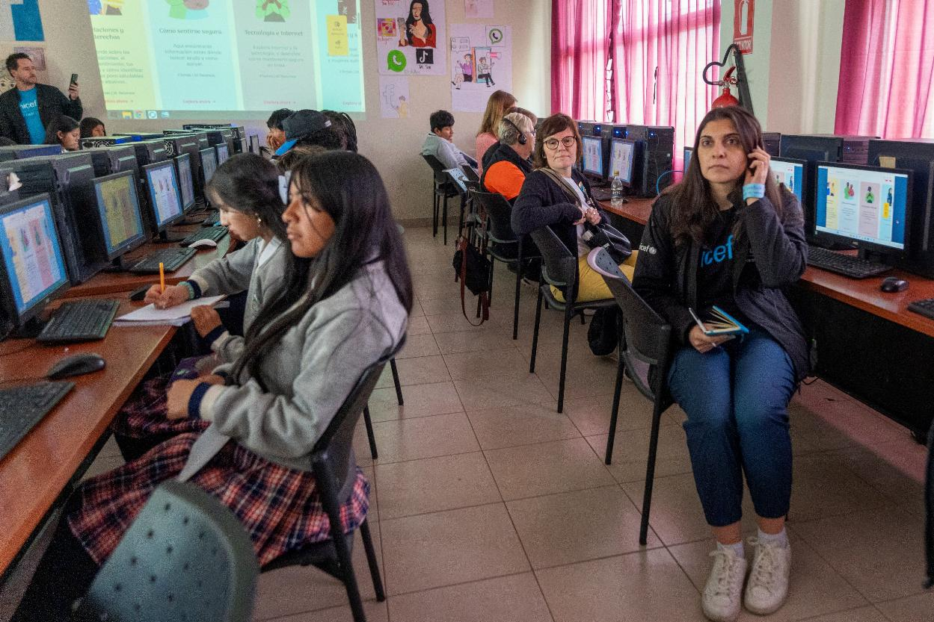
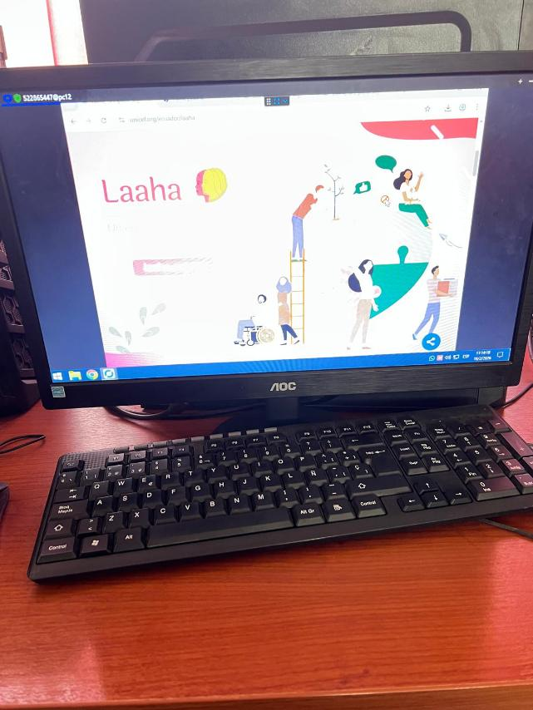
​
​The school introduced the Laaha platform to all the visitors.

Slide 13
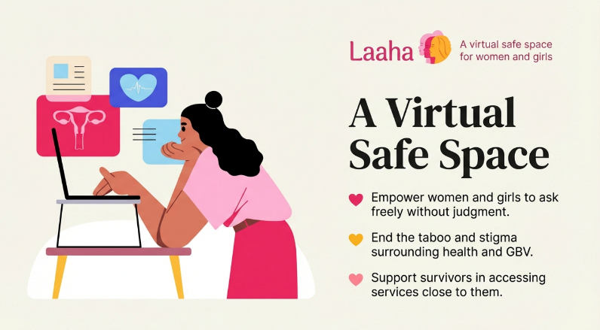
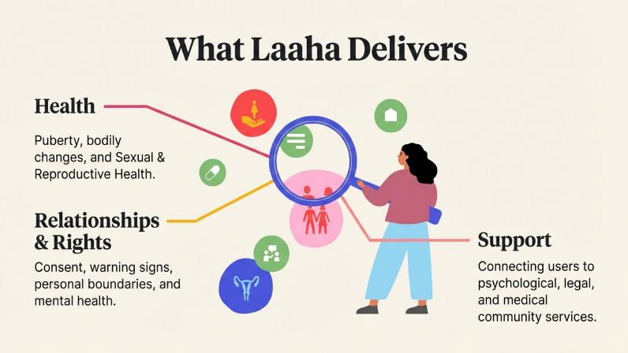
Laaha is a virtual safe space where adolescents can learn about sexual and reproductive health, safe relationships and rights, and where to connect for support.

Slide 14
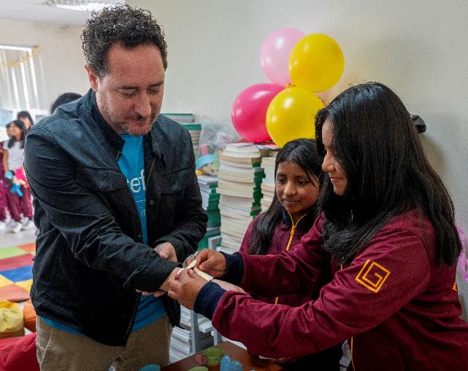
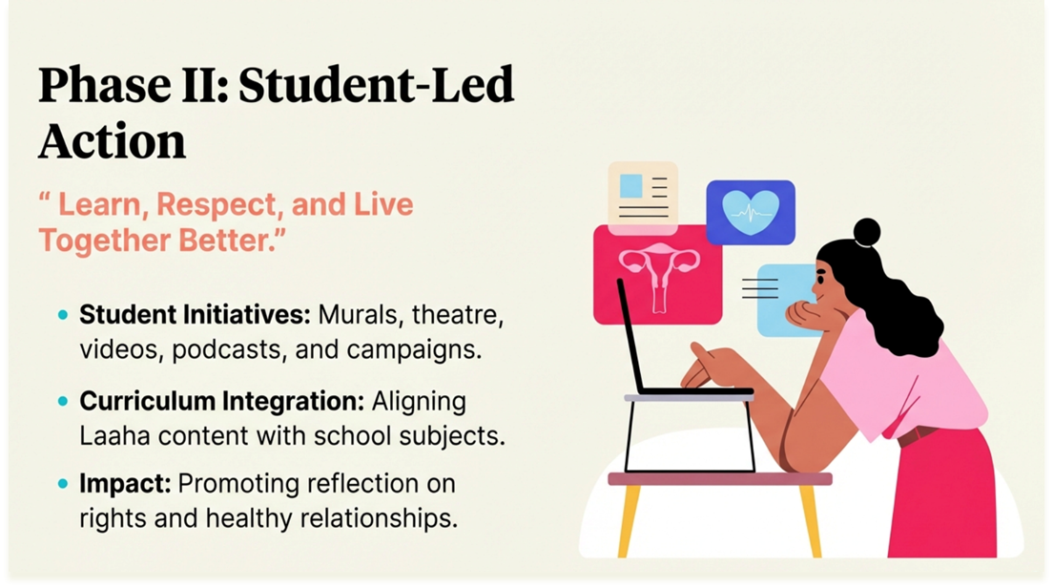
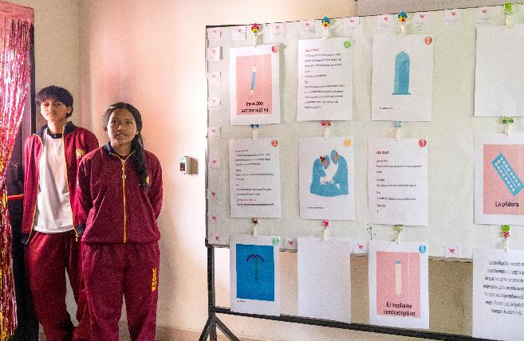
​
​The visitors were invited to engage with the students through 8 creative and unique student-led activity stations where they shared the information they learned from Laaha.

Slide 15
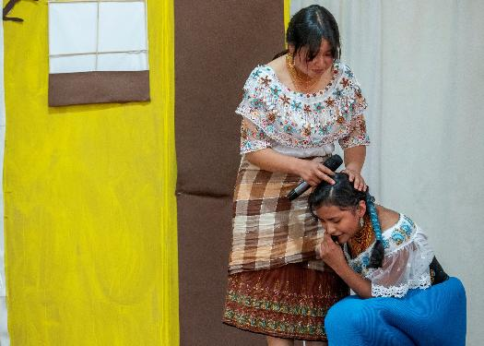
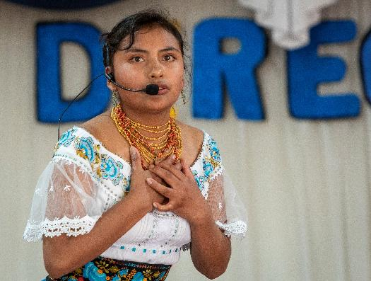
Student led activity stations
A student led theater production presented powerful messages on healthy relationships, rights and support services.

Slide 16
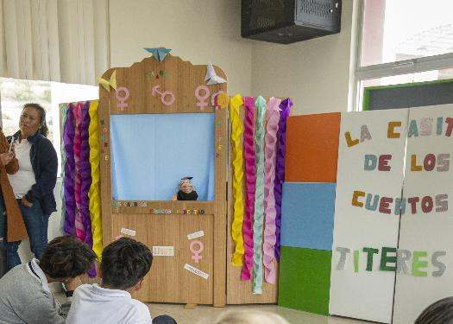
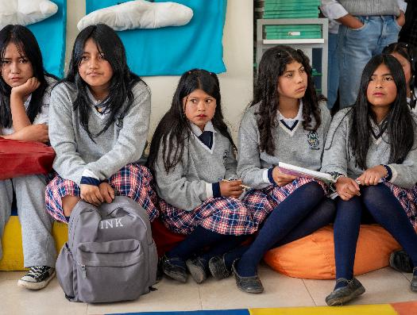
Student led activity stations
The students created a puppet show to teach the visiting students about sexual and reproductive health.

Slide 17
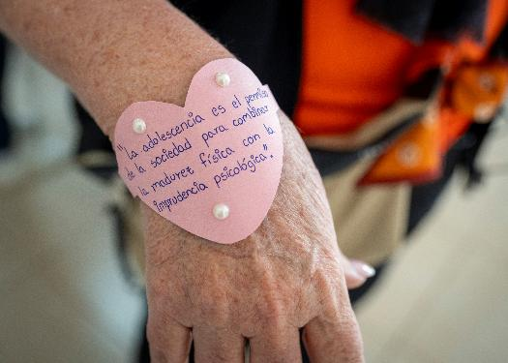
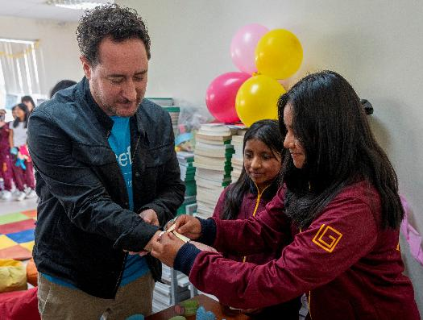
Student led activity stations
Students distributed handmade bracelets with powerful messaging.

Slide 18
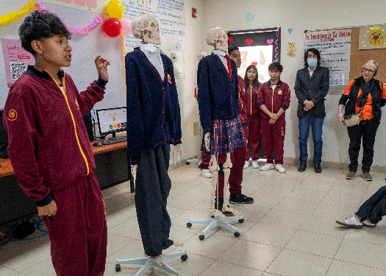
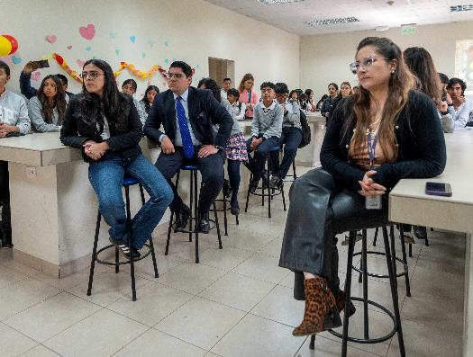
Student led activity stations
The students used innovative approaches to teach safe and unsafe touch using red, yellow and green light visual tools to facilitate learning.

Slide 19
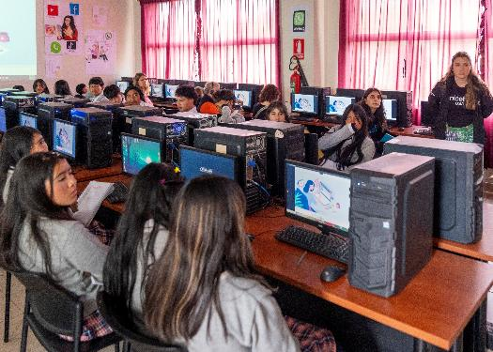
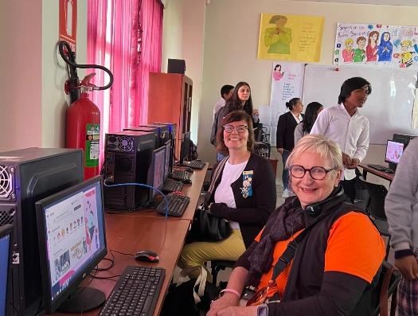
Student led activity stations
Information on internet safety was presented in another station located in the school computer lab.

Slide 20
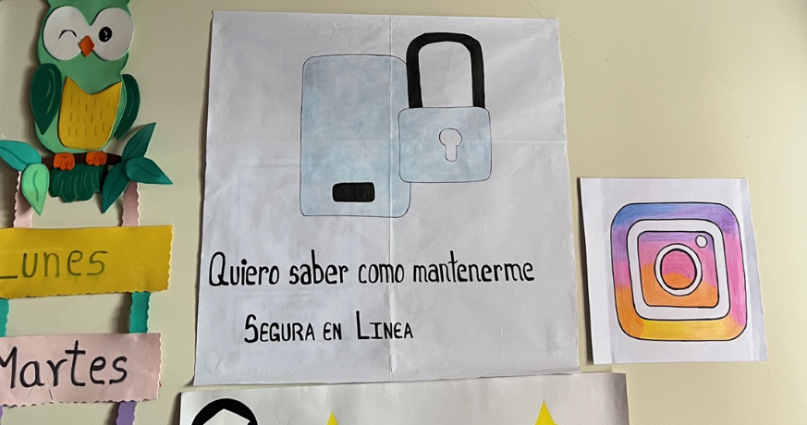
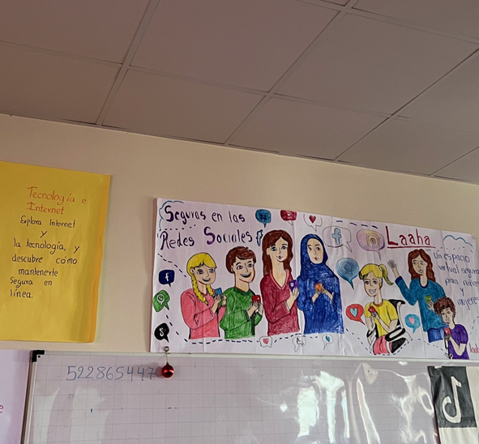
The classrooms were decorated in colorful murals with messages on technology safety
“To know how to stay safe online”

Slide 21
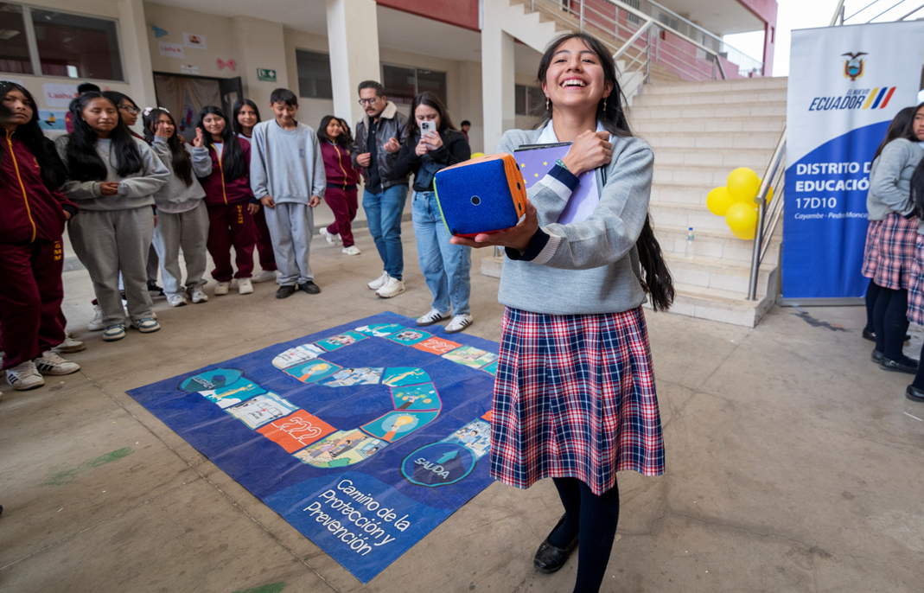
Life size board games developed by the students to facilitate learning were also introduced to the visitors.

Slide 22
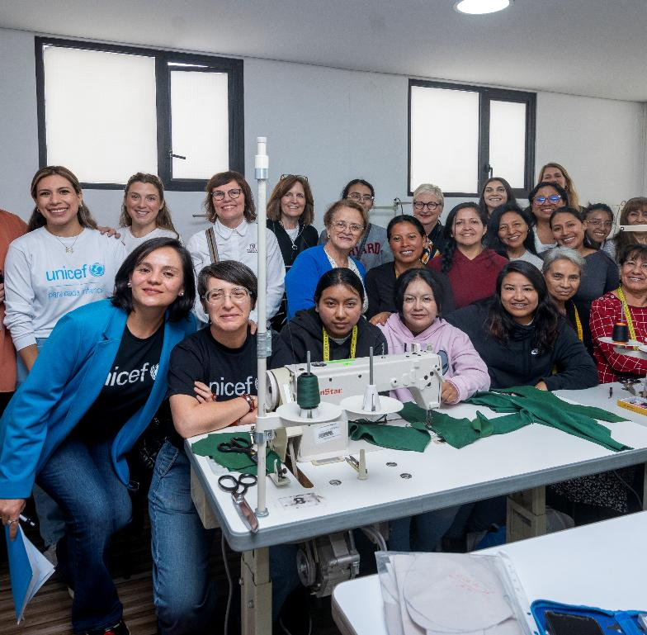
DAY 3
Visit to Centro Pichincha Bicentenaria de Calderón

Slide 23
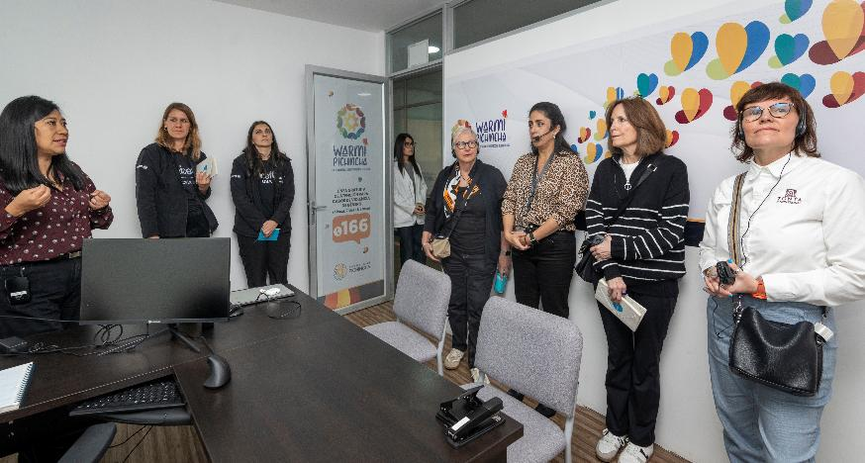
Visit to Centro Pichincha Bicentenaria de Calderón
Provides integrated community services aimed at improving quality of life, especially for vulnerable groups (women, youth, families and marginalized populations)
Offers a wide range of healthcare services, including general medicine, gynecology, pediatrics, psychology, dentistry, physiotherapy, and diagnostic services (e.g. X-ray, ultrasound)
Includes sexual and reproductive health services, with targeted support for adolescents and specialized services for LGBTIQ+ communities

Slide 24
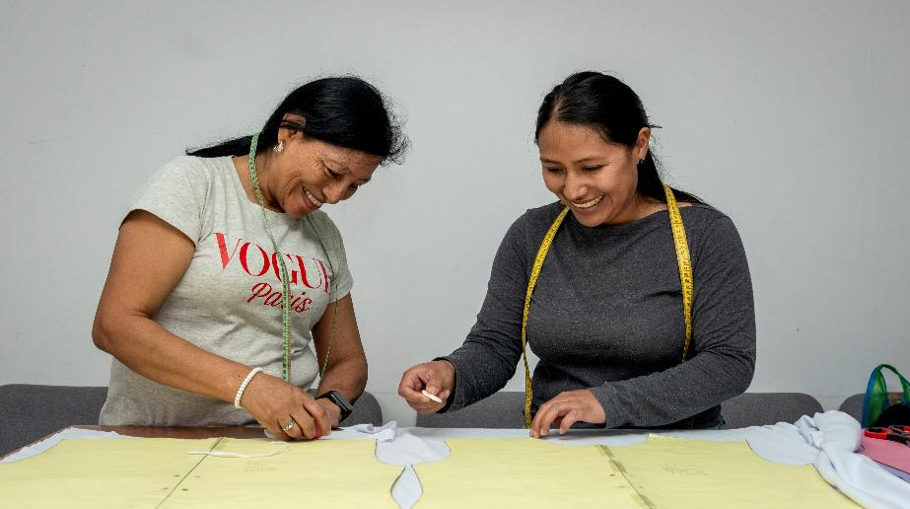
Visit to Centro Pichincha Bicentenaria de Calderón
Provides support for survivors of gender-based violence, including psychological care, legal advice and social assistance
Offers legal and mediation services to help resolve conflicts and improve access to justice within the community
Promotes economic empowerment, with coworking spaces, entrepreneurship support and vocational training such as textile skills development
Provides youth-focused programmes, including education on rights, health, and personal development

Slide 25
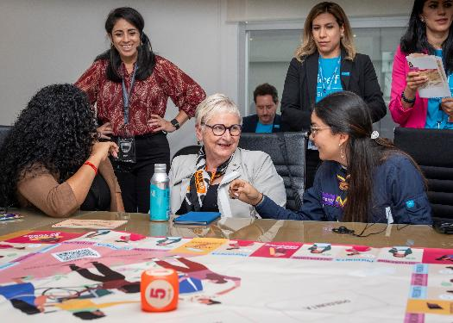
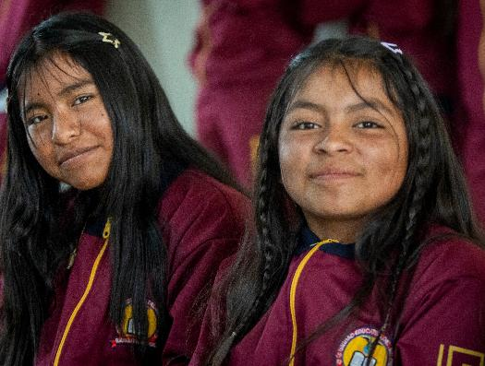
Laaha in Ecuador: reflections from site visit
Strong evidence of impact and relevance
Laaha is clearly highly relevant in Ecuador and already demonstrates strong, tangible impact in improving knowledge, confidence and access to support among adolescent girls and young women.
Model implementation – but not yet globally uniform
Ecuador UNICEF team appears to be very well progressing with the project with advanced localization, strong partnerships and high youth engagement; however, similar progress may not yet be at the same level across all Laaha countries, highlighting the need for continued adaptation and support.
Outstanding youth ownership and integration
The level of youth-led co-creation and engagement (e.g. schools, peer learning, creative teaching methods) shows that Laaha can be deeply embedded in communities and education systems when properly supported.

Slide 26
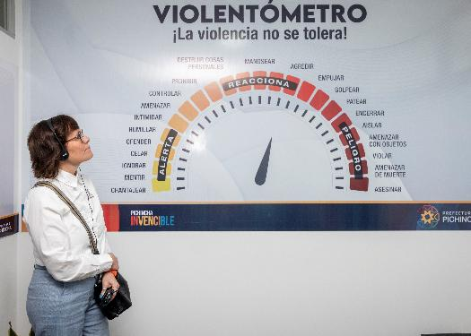
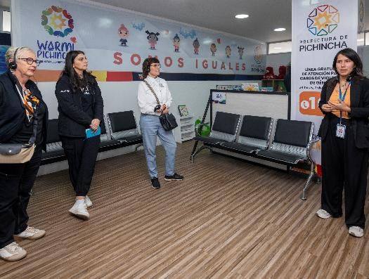
Laaha in Ecuador: reflections from site visit
Favorable but evolving policy environment
A recent national legislative change may risk reducing e.g.g institutional support and funding for gender equality and GBV-related services, potentially affecting e.g. centre visited; the legislation is reportedly under legal challenge, and its full impact remains uncertain.
Strong government and institutional relationships
The Ecuador team benefits from good collaboration with national and local authorities, which is a key enabler for scaling and sustainability.

Slide 27
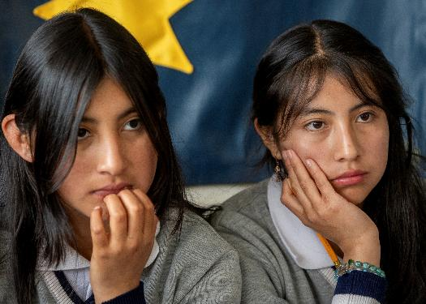
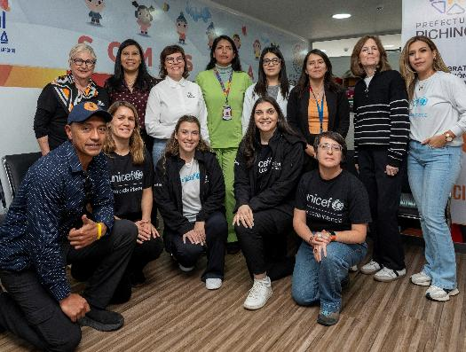
Laaha in Ecuador: reflections from site visit
Need to strengthen system-wide awareness (incl. police)
It is important to ensure that frontline authorities, especially police and protection services, are well aware of Laaha so they can refer girls and women both in crisis situations and for prevention to trusted information and services.
Importance of engaging men and boys
Addressing violence requires broader societal change; therefore, men and boys must be actively included in awareness, education and prevention efforts, as they are a critical part of the solution.

Slide 28
Thank you!
Thank you to UNICEF USA and the
Ecuador UNICEF country office for their
hardwork and dedication to the
Zonta International delegates’ site visit.

